Slide 1
PL/SQL and control statements

Slide 2
PL/SQL Introduction
PL/SQL stands for “Procedural Language extensions to the Structured Query Language”.
SQL is a popular language for both querying and updating data in the relational database management systems (RDBMS).
PL/SQL adds many procedural constructs to SQL language to overcome some limitations of SQL.
Besides, PL/SQL provides a more comprehensive programming language solution for building mission-critical applications on Oracle Databases.

Slide 3
PL/SQL Introduction
PL/SQL is a highly structured and readable language. Its constructs express the intent of the code clearly. Also, PL/SQL is a straightforward language to learn.
PL/SQL is a standard and portable language for Oracle Database development. If you develop a program that executes on an Oracle Database, you can quickly move it to another compatible Oracle Database without any changes.
PL/SQL is an embedded language. PL/SQL only can execute in an Oracle Database. It was not designed to use as a standalone language like Java, C#, and C++. In other words, you cannot develop a PL/SQL program that runs on a system that does not have an Oracle Database.

Slide 4
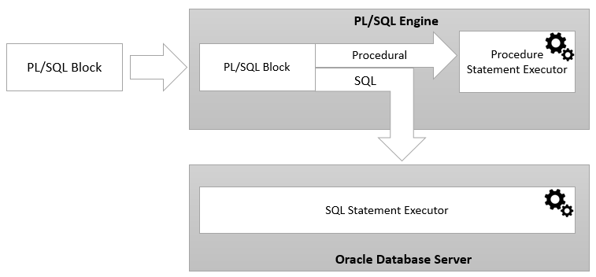
PL/SQL architecture

Slide 5
PL/SQL architecture
PL/SQL engine is in charge of compiling PL/SQL code into byte-code and executes the executable code.
The PL/SQL engine can only be installed in an Oracle Database server or an application development tools.
Once you submit a PL/SQL block to the Oracle Database server, the PL/SQL engine collaborates with the SQL engine to compile and execute the code.
PL/SQL engine runs the procedural elements while the SQL engine processes the SQL statements.

Slide 6
PL/SQL
PL/SQL is a combination of SQL along with the procedural features of programming languages.
Basic Syntax of PL/SQL which is a block-structured language; this means that the PL/SQL programs are divided and written in logical blocks of code. Each block consists of three sub-parts
Every PL/SQL statement ends with a semicolon (;).
Following is the basic structure of a PL/SQL block −
DECLARE <declarations section> BEGIN <executable command(s)> EXCEPTION <exception handling> END;

Slide 7
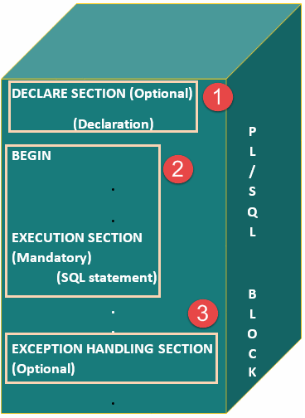
Pl/SQL Block structure

Slide 8
Pl/SQL Block structure Explanation
Sections | Description
Declarations | This section starts with the keyword DECLARE. It is an optional section and defines all variables, cursors, and other elements to be used in the program.
Executable Commands | This section is enclosed between the keywords BEGIN and END and it is a mandatory section. It consists of the executable PL/SQL statements of the program. It should have at least one executable line of code.
Exception Handling | This section starts with the keyword EXCEPTION. This optional section contains exception(s) that handle errors in the program.

Slide 9

The 'Hello World' Example
DECLARE
msg varchar2(20):= 'Hello, World!'; BEGIN
dbms_output.put_line(message); END; /

Slide 10
PL/SQL data types
Each value in PL/SQL such as a constant, variable and parameter has a data type that determines the storage format, valid values, and allowed operations.
PL/SQL has two kinds of data types: scalar and composite. The scalar types are types that store single values such as number, Boolean, character, and datetime whereas the composite types are types that store multiple values, for example, record and collection.
This tutorial explains the scalar data types that store values with no internal components.
PL/SQL divides the scalar data types into four families:
Number
Boolean
Character
Datetime

Slide 11
PL/SQL data types
A scalar data type may have subtypes. A subtype is a data type that is a subset of another data type, which is its base type.
A subtype further defines a base type by restricting the value or size of the base data type.
Note that PL/SQL scalar data types include SQL data types and its own data type such as Boolean.
Numeric data types
The numeric data types represent real numbers, integers, and floating-point numbers. They are stored as NUMBER, IEEE floating-point storage types.
Boolean data type
The BOOLEAN datatype has three data values: TRUE, FALSE, and NULL. Boolean values are typically used in control flow structure such as IF-THEN, CASE, and loop statements like LOOP, FOR LOOP, and WHILE LOOP.

Slide 12
PL/SQL data types
Character data types
The character data types represent alphanumeric text. PL/SQL uses the SQL character data types such as CHAR, VARCHAR2, LONG, RAW, LONG RAW.
Datetime data types
The datetime data types represent dates, timestamp with or without time zone and intervals.
PL/SQL datetime data types are DATE, TIMESTAMP, TIMESTAMP WITH TIME ZONE, TIMESTAMP WITH LOCAL TIME ZONE, INTERVAL YEAR TO MONTH, and INTERVAL DAY TO SECOND.

Slide 13
PL/SQL Variables
In PL/SQL, a variable is named storage location that stores a value of a particular data type.
The value of the variable changes through the program.
Before using a variable, you must declare it in the declaration section of a block.
Declaring variables
The syntax for a variable declaration is as follows:
variable_name datatype [NOT NULL] [:= initial_value];
In this syntax:
First, specify the name of the variable.
Second, choose an appropriate data type for the variable, depending on the kind of value which you want to store.

Slide 14
PL/SQL Variables
Example:
DECLARE
l_total_sales NUMBER(15,2);
l_credit_limit NUMBER (10,0);
l_contact_name VARCHAR2(255);
BEGIN
NULL;
END;
PL/SQL allows you to set a default value for a variable at the declaration time. To assign a default value to a variable, you use the assignment operator (:=) or the DEFAULT keyword.
Example
DECLARE
l_product_name VARCHAR2( 100 ) := 'Laptop';
BEGIN
NULL;
END;

Slide 15
PL/SQL IF Statement
The IF statement allows you to either execute or skip a sequence of statements, depending on a condition. The IF statement has the three forms:
– IF THEN
– IF THEN ELSE
– IF THEN ELSIF
You can nest an IF statement within another IF statement.

Slide 16
PL/SQL IF Statement
Example:
DECLARE
n_sales NUMBER := 300000;
n_commission NUMBER( 10, 2 ) := 0;
BEGIN
IF n_sales > 200000 THEN
n_commission := n_sales * 0.1;
ELSIF n_sales <= 200000 AND n_sales > 100000 THEN
n_commission := n_sales * 0.05;
ELSIF n_sales <= 100000 AND n_sales > 50000 THEN
n_commission := n_sales * 0.03;
ELSE
n_commission := n_sales * 0.02;
END IF;
END;

Slide 17
PL/SQL LOOP
You can use basic PL/SQL LOOP statement to repeat a block of code until a condition is met.
The PL/SQL LOOP statement has the following structure:
<<label>> LOOP
statements;
END LOOP loop_label;
This structure is the most basic of all the loop constructs including FOR LOOP and WHILE LOOP.
This basic LOOP statement consists of a LOOP keyword, a body of executable code, and the END LOOP keywords.

Slide 18
PL/SQL LOOP
The LOOP statement executes the statements in its body and returns control to the top of the loop.
Typically, the body of the loop contains at least one EXIT or EXIT WHEN statement for terminating the loop. Otherwise, the loop becomes an infinite loop.
The LOOP statement can have an optional label that appears at the beginning and the end of the statement.
It is a good practice to use the LOOP statement when:
You want to execute the loop body at least once.
You are not sure the number of times you want the loop to execute.
It is possible to nest a LOOP statement within another LOOP statement

Slide 19
PL/SQL LOOP Example
DECLARE
l_counter NUMBER := 0;
BEGIN
LOOP
l_counter := l_counter + 1;
IF l_counter > 3 THEN
EXIT;
END IF;
dbms_output.put_line( 'Inside loop: ' || l_counter ) ;
END LOOP;
-- control resumes here after EXIT
dbms_output.put_line( 'After loop: ' || l_counter );
END;
Here is the output:
Inside loop: 1
Inside loop: 2
Inside loop: 3
After loop: 4

Slide 20



Types of PL/SQL block
PL/SQL blocks are of mainly two types.
Anonymous blocks
Named Blocks

Slide 21


Anonymous blocks: Unnamed
Anonymous blocks are PL/SQL blocks which do not have any names assigned to them.
They need to be created and used in the same session because they will not be stored in the server as a database objects.
Since they need not to store in the database, they need
no compilation steps.
They are written and executed directly, and compilation and execution happen in a single process.

Slide 22

Anonymous blocks: Unnamed
Below are few more characteristics of Anonymous blocks.
These blocks don't have any reference name specified for them.
These blocks start with the keyword 'DECLARE' or 'BEGIN'.
These blocks can have all three sections of the block, in which execution section is mandatory, the other two sections are optional.

Slide 23




Named blocks:
Named blocks are having a specific and unique name for them.
They are stored as the database objects in the server.
Since they are available as database objects, they can be referred to or used as long as it is present in the server.
The compilation process for named blocks happens separately while creating them as a database objects.

Slide 24

Named blocks:
Below are few more characteristics of Named blocks.
These blocks can be called from other blocks.
The block structure is same as an anonymous block, except it will never start with the keyword 'DECLARE'. Instead, it will start with the keyword 'CREATE' which instruct the compiler to create it as a database object.
These blocks can be nested within other blocks. It can also contain nested blocks.
Named blocks are basically of two types:
Procedure
Function

Slide 25

Unnamed block Examples
Not possible in MySQL but possible with oracle SQL

Slide 26
Unnamed block Examples-SQL
SQL> declare
2 a number:=1;
3 begin
4 for a in 1..10 loop
5 dbms_output.put_line(a);
6 end loop;
7 end;
•
SQL> declare
2 a number:=1;
3 begin
4 loop
5 dbms_output.put_line(a);
6 a:=a+1;
7 exit when a>10;
8 end loop;
9 end;
•
// For loop
//Simple loop

Slide 27
Unnamed block Examples-SQL
SQL> declare
2 a number:=1;
3 begin
4 while a<11 loop
5 dbms_output.put_line(a);
6 a:=a+1;
7 end loop;
8 end;
•
SQL> declare
2 a number(4);
3 begin
4 for a in 5..15 loop
5 if mod(a,5)=0 then
6 dbms_output.put_line(a);
7 else
8 dbms_output.put_line('value'||a);
9 end if;
10 end loop;
11 end;
//While loop
// if-else

Slide 28
END

